Slide 1
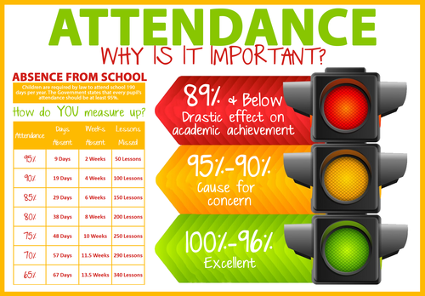
Working Together to Improve Bond Attendance

Slide 2

2025-2026 target – 94.1%
Actual attendance: 93.0%
National attendance for primary schools – 94.69%
National attendance for all schools -93.07%
“Attendance is everyone’s responsibility. Excellent attendance underpins both academic success and safeguarding”

Slide 3
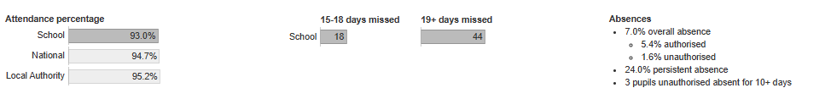
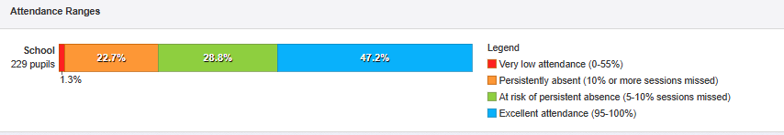
Attendance at Bond 2025-2026

Slide 4
Attendance at Bond 2025-2026 contd.

Slide 5
Importance of School Attendance
The law on school attendance
Right to a full-time education
Data on link between attainment and absence and well being
Regular attendance as a protective factor
Vulnerable pupils –absence
          where are they,
          what are they doing,
          who are they with,
          are they safe?

Slide 6
Attendance MAtters
National attendance - 93%
90% attendance sounds good? Actually equates to 19 missed days of school across an academic year –(one day every two weeks)
So What?
90% attendance means missing over a year of school by the time a child completes their education
Direct correlation between poor attendance and lower GCSE outcomes and increased safeguarding vulnerabilities

Slide 7
‘Build strong relationships and work jointly with families…’
Good attendance starts with close and productive relationships with parents
Share link between attendance, attainment and wellbeing
Where absence is problematic –draw on the relationships the earlier the better
Understand barriers thorough relationship and informal meetings
Address in school barriers through support
External barriers –work together and involve partners if needed
No improvement or engagement
Formal meeting and escalation

